Slide 1

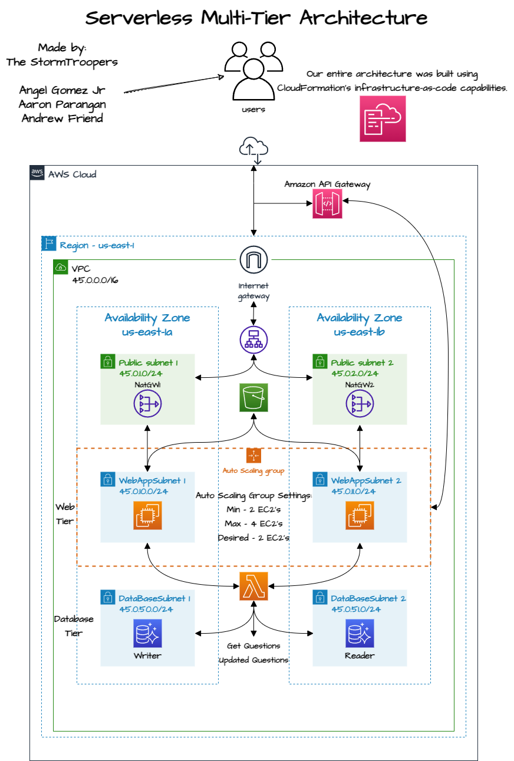
StormTrooper’s Multi-tier architecture
Multi-tier
Architecture
Built Entirely Using Infrastructure as code with amazon cloudformation
StormTroopers:
Angel Gomez Jr
Aaron Parangan
Andrew Friend
Multi-tier
Architecture

Slide 2



Objective:
Everett Enterprises is a startup that provides online practice exams for individuals preparing for the AWS Solutions Architect Associate (SAA) and AWS Certified Cloud Practitioner (CCP) exams. They currently host their website and exam questions in an on-premises data center but have decided to move to the cloud due to the financial and performance improvements. It is critical that the website and exam questions are available to users without any interruption, and the company needs a fast, scalable, reliable, and cost-effective solution for their business requirements.
We have been hired to assist the company with the transition. Our task is to design a cloud-based infrastructure that can meet the needs of the business, including hosting the website, storing exam questions and data, and ensuring high availability and scalability of the system.

Slide 3

Multi-tier Architecture design

Slide 4





Thank You!
Angel Gomez JR
LinkedIn:
Aaron Paragan
LinkedIn:
Andrew Friend
LinkedIn:

